Slide 1
CS 321-Analysis of Algorithms
Lecture 04
Master’s Theorem/Method
Instructor: Asim Rehan
arehan@numl.edu.pk
National University of Modern Languages, Islamabad

Slide 2
Methods to solve recurrence
Substitution method
Iteration method
Recursion tree method
Master’s Theorem

Slide 3
Master’s Theorem/Method
“Cookbook” for solving recurrences of the form:
where, a ≥ 1, b > 1, and k ≥ 0
Example: W(n) = 2W(n/2) + n²
a = no. of times recursive function called.
b = size of problem is divided in how many parts?
k = the power of n in the cost.
p = the power of log in the cost.

Slide 4
Examples:
Conditions: a ≥ 1, b > 1, and k ≥ 0
Recurrence Relations
Value
Value
Value
Value
Applicable?
of a
of b
of k
of p
T(n) = 3T(n/4) + n
3
4
2
0
Yes
2
T (n) = 2T (n/2) + n log n
2
2
1
1
Yes
T (n) = 4T (n/2) + log n
4
2
0
1
Yes
T(n) = 5T(n/3) + 1
5
3
0
0
Yes
T(n) = 4T(n/1) + n
4
1
1
0
No

Slide 5
Master’s Theorem/Method
Case 1: if a>b^{k},
then: T(n) = O (n^{log}_{b}ª)
Case 2: if a=b^{k}
If p>-1 , then: T(n) = O (n^{log}_{b}ª log^{p+1} n)
If p=-1 , then: T(n) = O (n^{log}_{b}ª loglogn)
If p<-1 , then: T(n) = O (n^{log}_{b}ª)
Case 3: if a<b^{k}
If p>=0 , then: T(n) = O (n^{k} log^{p} n)
If p<0 , then: T(n) = O (n^{k})

Slide 6
Examples:
T(n) = 2T(n/2) + n
T(n) = 2T(n/2) + n²
T(n) = 3T(n/4) + cn²
T(n) = 4T(n/2) + log n

Slide 7
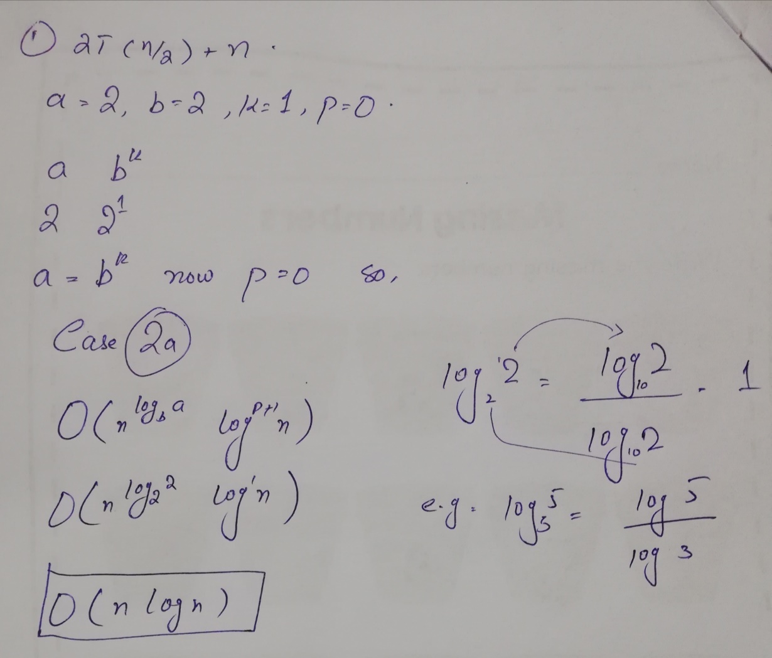
Example 1
T(n) = 2T(n/2) + n

Slide 8
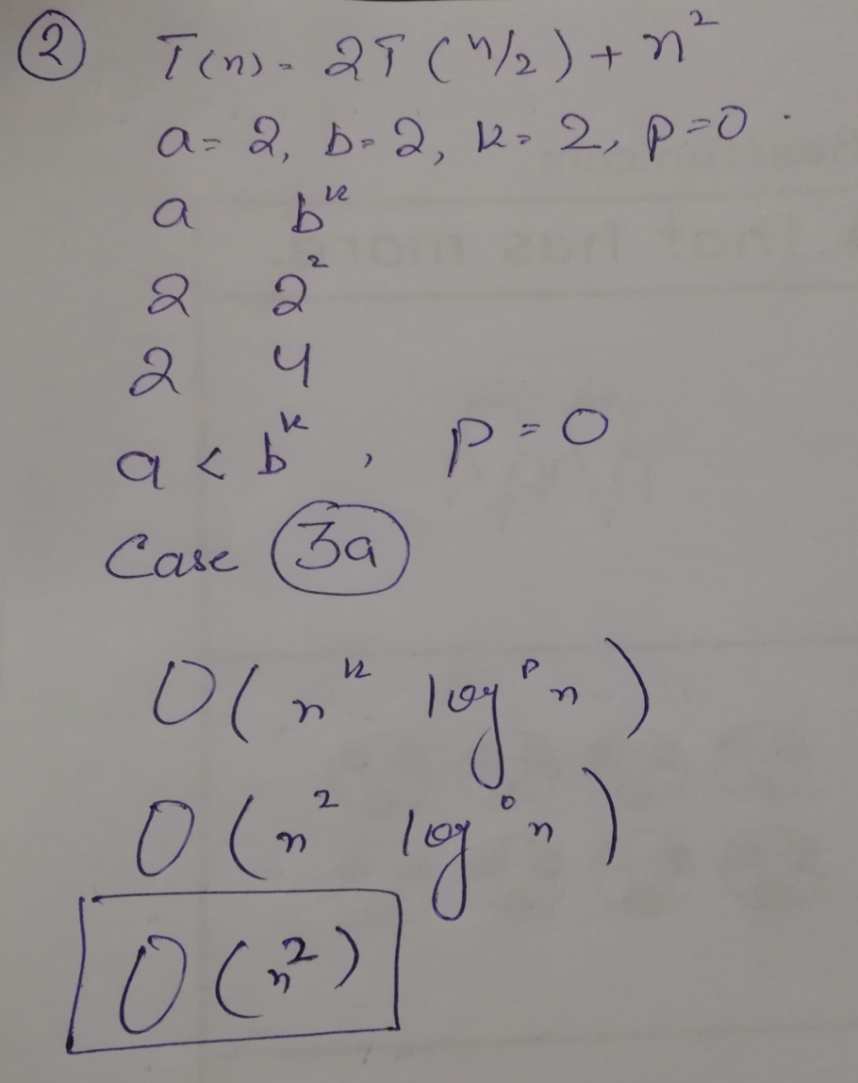
Example 2
T(n) = 2T(n/2) + n²

Slide 9
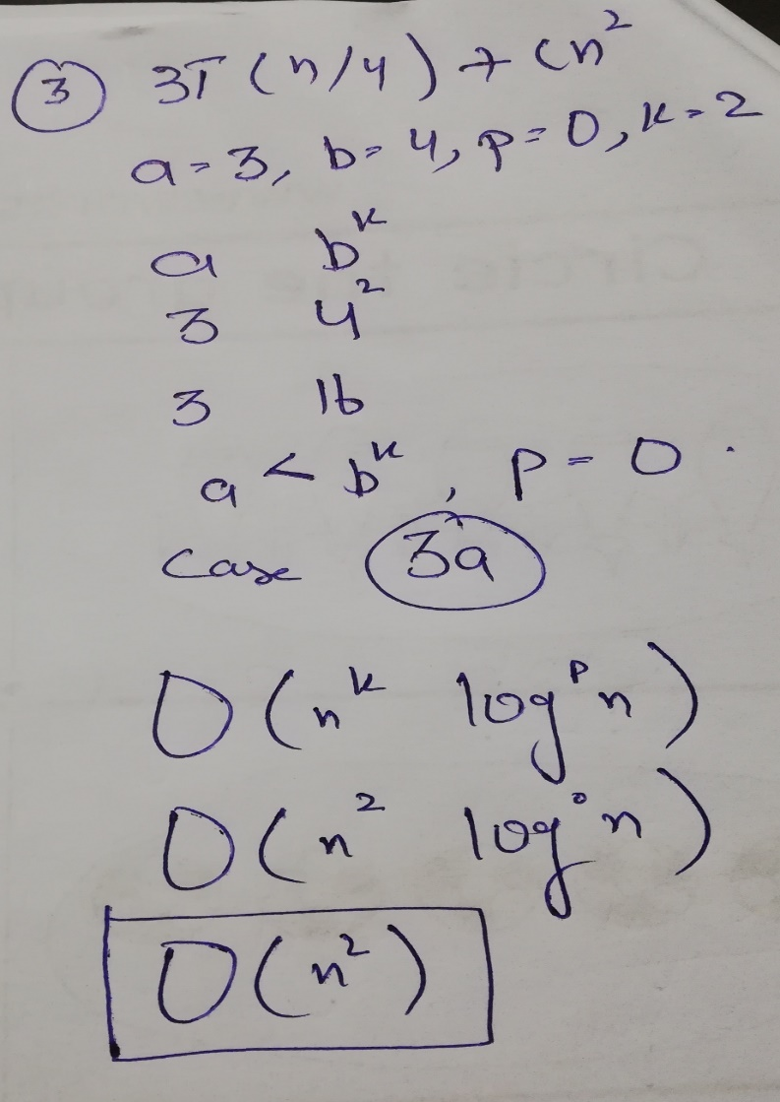
Example 3
T(n) = 3T(n/4) + cn²

Slide 10
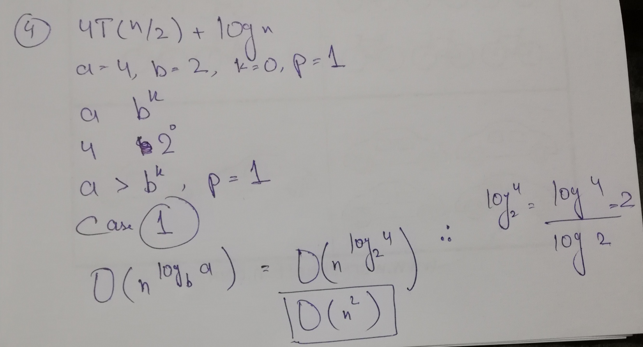
Example 4
T(n) = 4T(n/2) + log n

Slide 11
Questions

